Slide 1


MAXHUB WT15S
Wireless Screen Sharing
Dongle

Slide 2
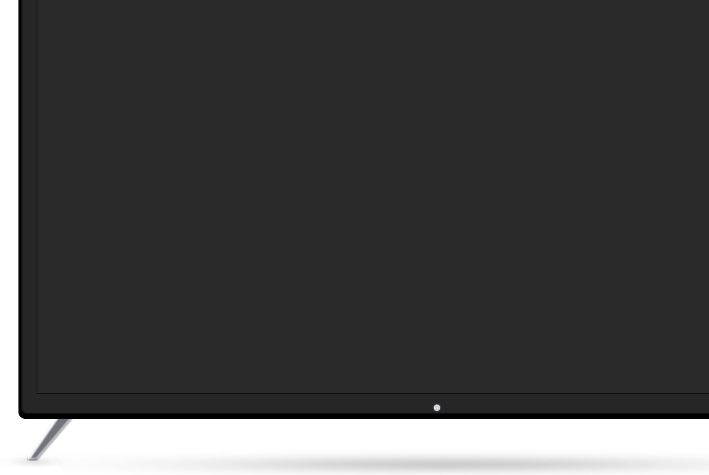

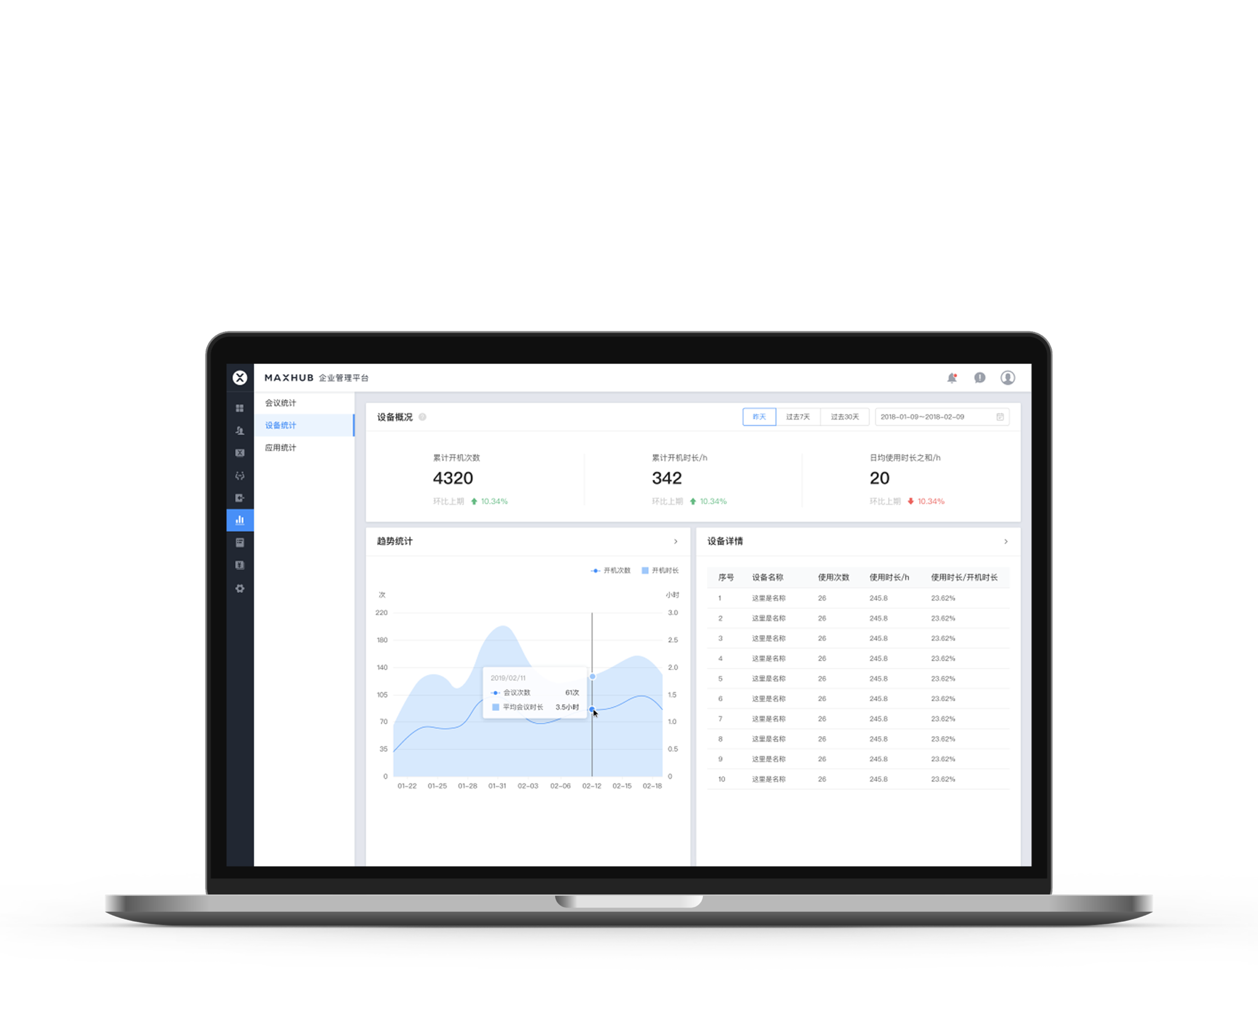
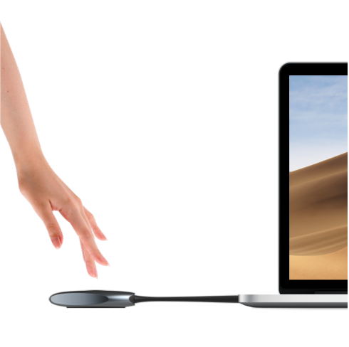
Feature Highlight | 4K Screen Sharing
4K@30fps Screen Sharing, Ultra-low Latency
Supports up to 4K resolution at 30fps, delivering high-definition presentation of meeting content.
Ultra-low latency of ≥90ms ensures a smooth and efficient screen sharing experience.

Slide 3

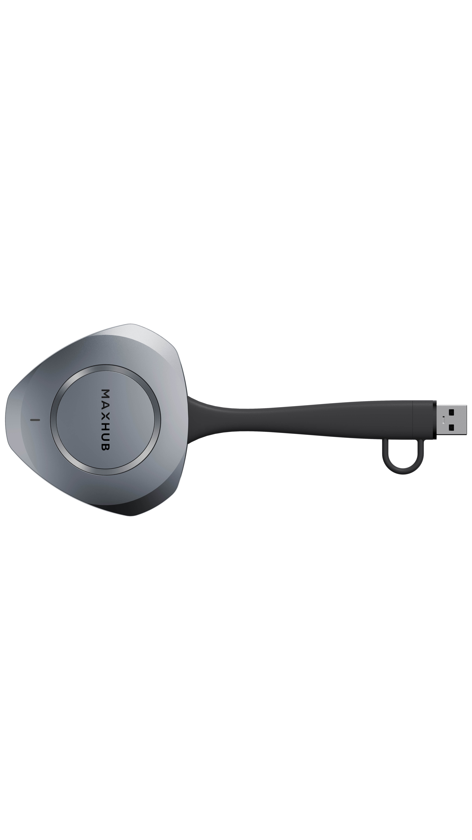
Feature Highlight | 3-Second Plug and Play
Plug and Play, Ready to Share in 3 Seconds
Ready for screen sharing in just *3 seconds after plugging into the computer.
The dongle features a built-in auto-start module that pre-launches the program before being plugged in.
*USB-C: ≥3s, USB-A: ≥10s

Slide 4
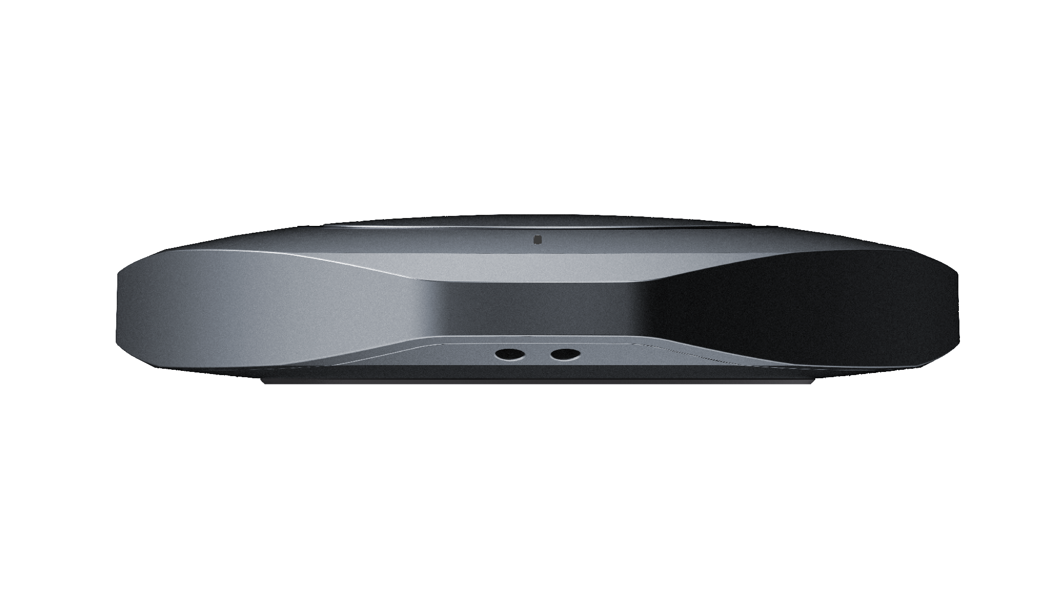
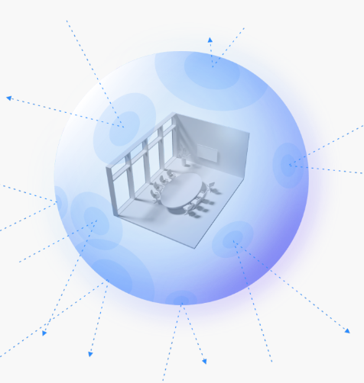
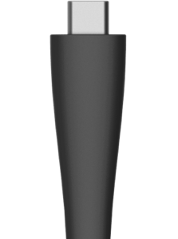
Feature Highlight | Built for Business
Durable Cable and Adapter
Thoughtful Anti-loss Design
Multi-layered Security Encryption
Rigorously tested to withstand over 20,000 bends, ensuring 3X long-lasting performance
Integrated USB adapter, enabling seamless switching between USB-C and USB-A interfaces
The dongle features a dedicated lanyard hole, allowing it to be securely attached to meeting tables or display devices, effectively preventing loss.
Utilizing AES 128-bit encryption algorithms.
Dynamic key negotiation and multi-factor authentication ensure every connection is independently secure

Slide 5
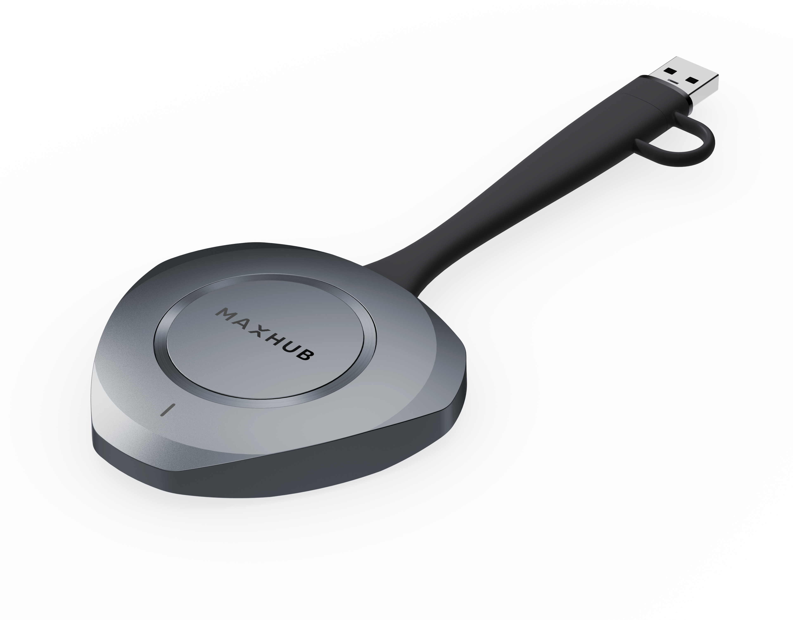
MAXHUB WT15 Wireless Dongle
Specification | MAXHUB WT15S
Screen Sharing | 4K @ 30fps 1080P @ 60fps
Screen Sharing Latency | ≥90 ms (Min.)
Audio/Video Decode | OPUS/H.264/H.265
Picture Quality and Color | YUV444/YUV420
Devices Connected | Up to 32 devices
Simultaneous Screen Sharing | Up to 9 devices
Connection Distance | Up to 12 meters
Connection Speed | ≥ 3s (USB-C), ≥ 10s (USB-A)

Slide 6
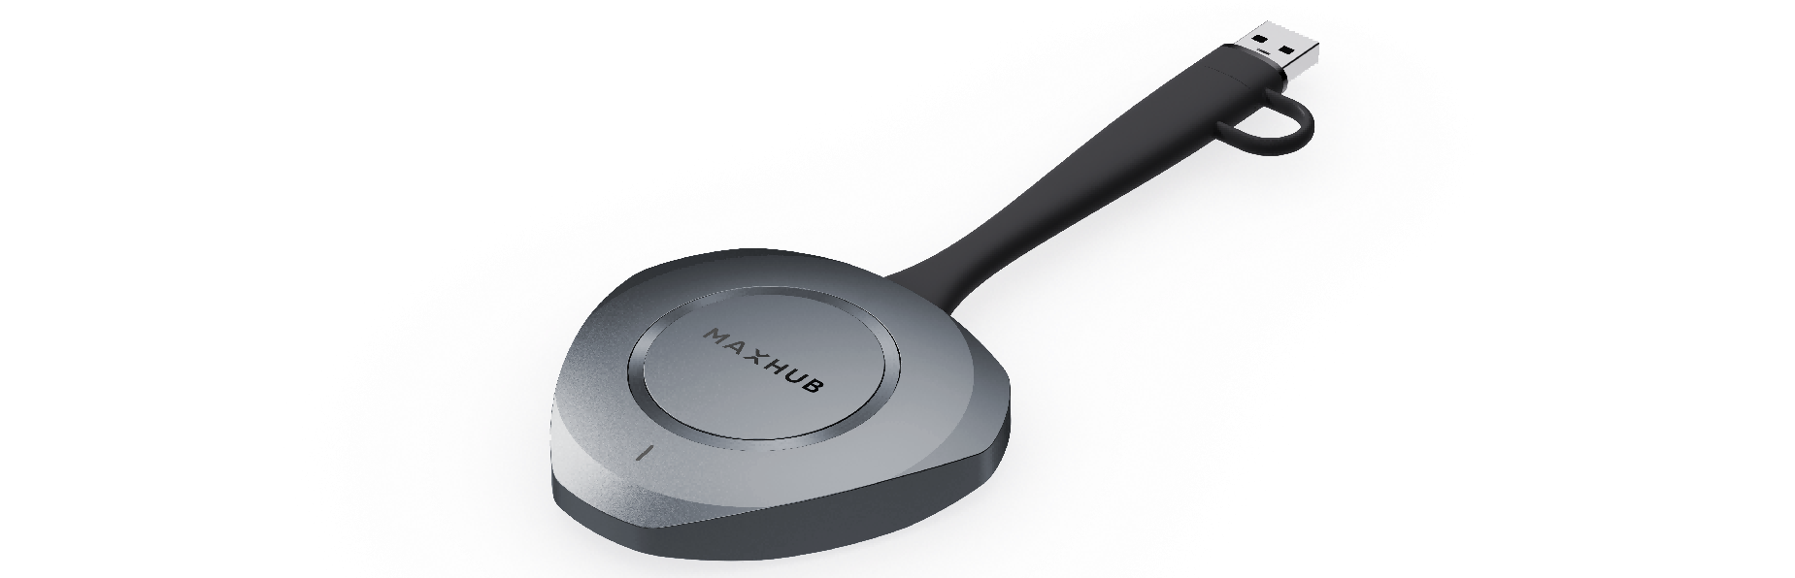
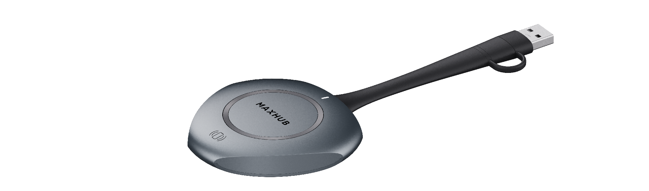
MAXHUB WT15 Wireless Dongle
WT15
WT13
ID Design
Connection Speed
≥ 3 seconds
≥ 5 seconds
Screen Share Latency
≥90ms
≥90ms (USB A), ≥120ms (USB C)
1080P@30fps (Hardware Decode)
36 Mbps (MJPEG)
1080P@30fps (Software Decode)
25 Mbps (MJPEG)
*BYOD Performance
Cable Durability
>20,000 bends
>7,000 bends
Wireless Connection
2T2R, Up to 12 meters
1T1R, Up to 8 meters
Anti-loss design
No Battary
Other Feature
-
*Not available in WT15S and WT13S

Slide 7
Competitive Comparison
Feature | MAXHUB WT15S | Barco ClickShare Gen5 | Yealink WPP30 | Crestron AM-TX3-100
Screen Share Resolution | 4K@30fps 1080P@60fps | 4K@30fps (DP only) | 4K@30fps | 4K@30fps
Screen Share Latency | ≥90ms ✦ | ~120ms | ~120ms (4K: ~200ms) | ~150ms
Connection Speed | 3s (USB-C) ✦ 10s (USB-A) | 7s | 7s | ~10s
Interface | USB-C + USB-A (Integrated) ✦ | USB-C only | USB-C/A Dual Port | USB-C only
Driver-Free | Yes ✦ | Yes | Yes | Yes
Touch Back | Yes ✦ | Yes | Yes | Yes
Multi-Screen Split | Up to 9 ✦ | Up to 4 | Up to 4 | Up to 4
Max Connections | 32 devices ✦ | 64 devices | N/A | N/A
WiFi | WiFi 5, 2T2R | WiFi 5, 2T2R | WiFi 6, 2T2R | WiFi 5
Range | 12m+ | 30m | N/A | 15m
Cable Durability | 20,000+ bends ✦ | N/A | N/A | N/A
Anti-Loss Design | Yes ✦ (Lanyard hole) | No | No | No
AES Encryption | 128-bit ✦ | Yes | Yes | Yes
Enterprise Management | Yes ✦ | Yes | Yes | Yes
Extended Screen & App Share | Yes ✦ | Yes | Yes | Yes
✦ = Key MAXHUB WT15 advantage | Data sourced from official specs & internal testing (May 2026)

Slide 8




Thanks.
www.maxhub.com
MAXHUB
sales@maxhub.com

